Slide 1
Comparison of thermal infrared measurements of CO₂ from GOSAT/GOSAT2 and IASI over the Arctic Ocean
Sébastien Payan⁽¹⁾, Jérôme Bureau⁽¹⁾, and Claude Camy-Peyret⁽²⁾
⁽¹⁾ LATMOS/IPSL/CNRS/Sorbonne Université, Paris, France
⁽²⁾ IPSL (Sorbonne Université/UVSQ) Paris, France
IASI Conference, December 6-10, 2021, Evian - France

Slide 2
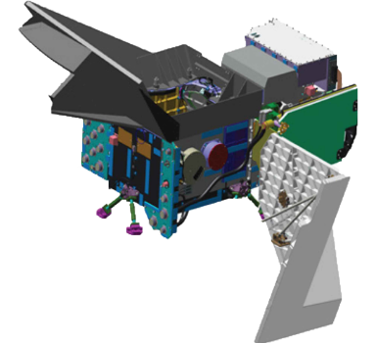
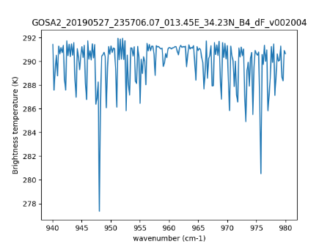
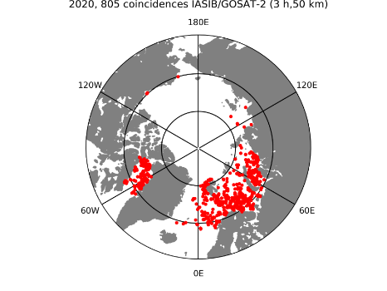
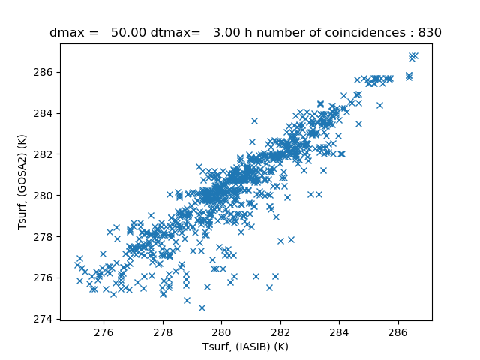
Context and Outline
Among the instruments performing remote sensing from space, measurements using Fourier transform spectrometers operating in the thermal infrared (TIR) spectral domain are not hampered by the requirement of not too large solar zenith angles as in SWIR measurements.
In this study we concentrate on the calibration/validation of the Thermal and Near Infrared Sensor for Carbon Observation (TANSO)–Fourier Transform Spectrometer (FTS2) spectra in the TIR spectral region (B4 & B5 band) over the Arctic Ocean
The changes in the various versions of L1b products in TIR bands were resulting in different retrieved products
Our goal was to quantify the differences between versions and to contribute to the assessment of the quality of the successive new versions
We will present feedback on TANSO-FTS&FTS2 Cal/Val activities
Rationale for this study and evolution of the L1B versions in TANSO-FTS2 band B4 & B5.
Retrieval scheme in the TIR for the 10.4 µm window for spectra collected by GOSAT over the ice free Arctic Ocean in summer.
Comparison with IASI.
Comparison between versions of TANSO-FTS/2 L1B.
Notes:
Justification

Slide 3
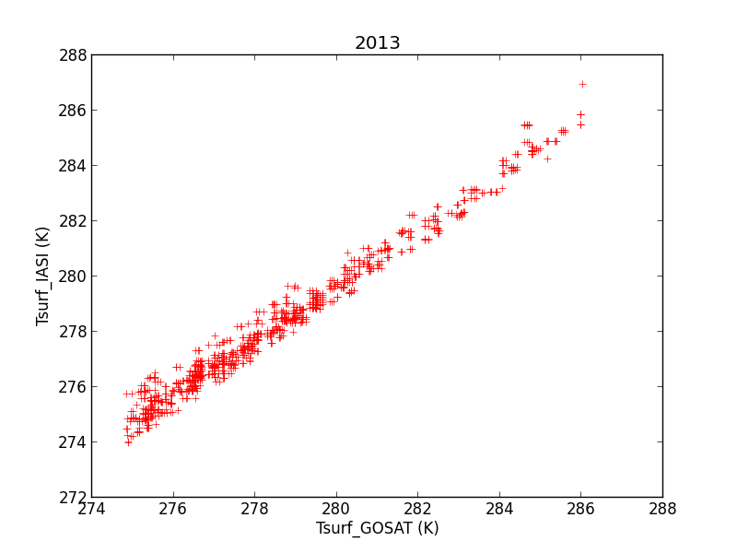
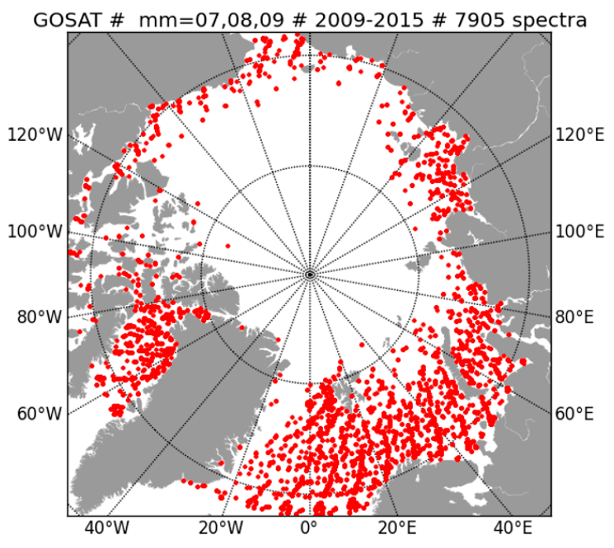
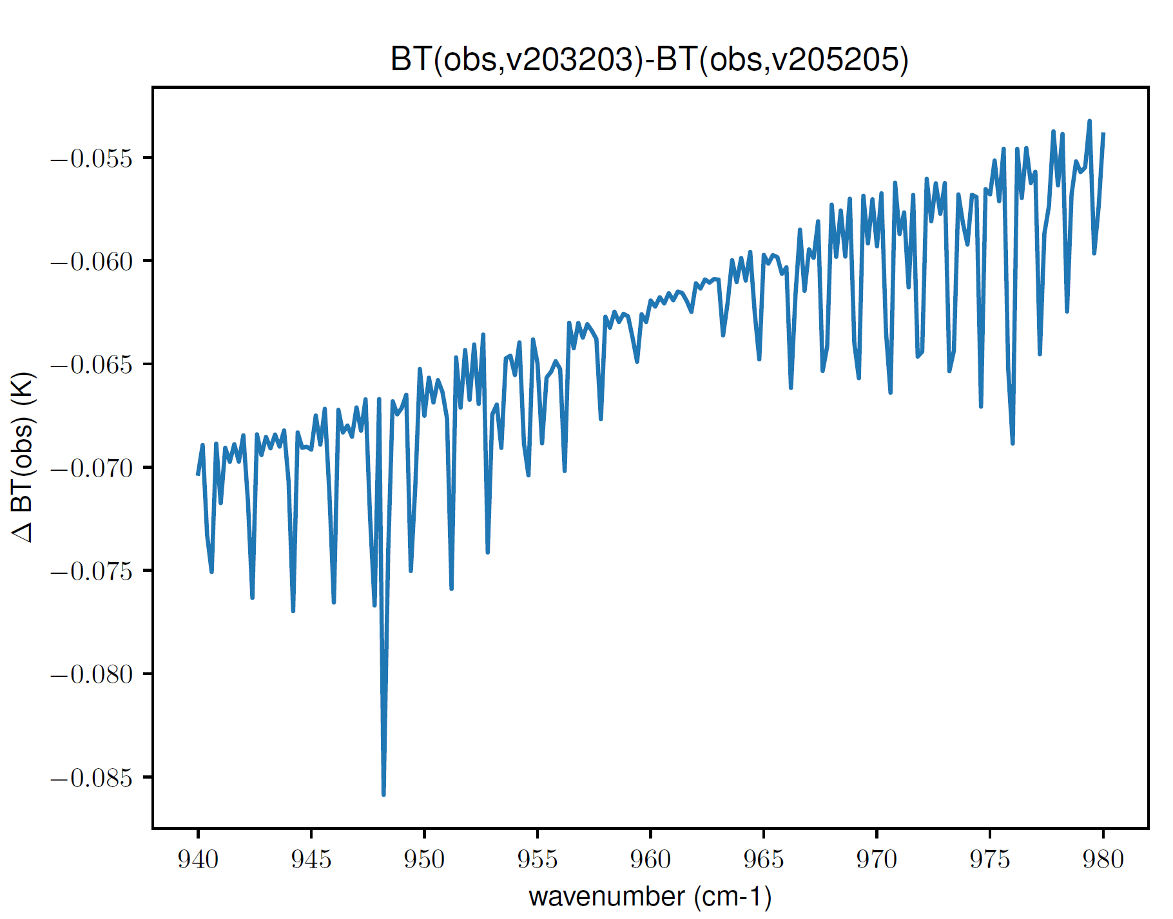
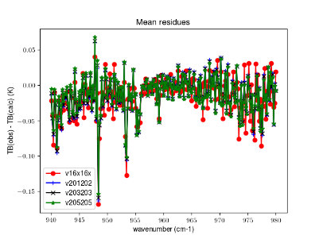
Previous results for GOSAT
Correlation between T_{surf} derived from TANSO-FTS and IASI-A in July/August 2013
As a contribution to the calibration/validation activities for GOSAT, we were wanting to use the TIR spectra of TANSO-FTS in B4 to compare our retrieved L2 GOSAT products with similar L2 IASI products obtained using IASI L1C spectra with exactly the same «home made» inversion configuration (LARA algorithm)
It appeared quickly that the changes in the various versions of L1b spectra in B4 were resulting in different retrieved L2 products
Our goal was to quantify the differences between versions and to contribute to the assessment of the quality of the successive versions
Radiometric comparison : mean spectra differences and residuals
Plot of the footprint position of selected TANSO-FTS "clear, sea, normal lapse rate, good line contrast" for year 2009 to 2015. we found
- 7905 negative lapse rate profiles,
- 3089 isothermal profiles
- 18951 profiles with temperature inversion
See Payan et al., Proc. SPIE 2016
Notes:
Justification

Slide 4
L2 results clear IFOVs, over sea and with a normal atmospheric lapse rate T(z) profile 1σ precision (not accuracy !) : - T_{surf} ~ 0.05 K - XCO₂ ~ 6 ppmv The variation of T_{surf} with latitude and between July/Aug/Sept is significant The inter-annual variability does not show a trend in T_{surf} at the regional scale The overall trend in the CO₂ column averaged VMR is well captured over the 9 years period for GOSAT
XCO₂ T_{surf}
OPD_{max}
Failure of the
cryo-cooler
Payan et al., Remote sensing 2017

Slide 5
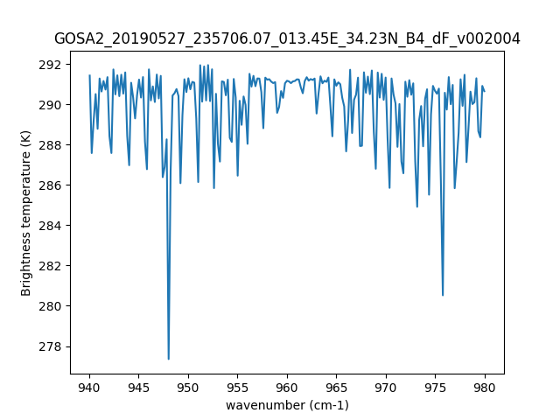
Retrieval scheme in the TIR for the 10.4 µm window for spectra collected by GOSAT-2 over the ice free Arctic Ocean in summer
Extended study for GOSAT-2
Inter-calibration of the L1B spectra
B5 (600-1200 cm⁻¹) and B4 (1180-1800 cm⁻¹) bands of GOSAT-2
Check of the instrument line shape (ILS) in the two TIR bands
Check of the impact of forward/backward scan of the OPD
Search for quasi-coincident footprints of GOSAT-2 and IASI (A, B and C)
Retrieval of T_{surf} and XCO₂ for coincident measurements
Comparison of the TIR L2 retrieved products
In addition, perform XSF₆ retrievals
Retrieval scheme :
Window: 940 - 980 cm⁻¹, "CO₂ laser band region"
State vector: x=(T_{surf}, coeff_CO₂, coeff_H₂O, coeff_O₃)
Diagonal covariance matrix S_{y} (L1B unapodised spectra)
No a priori for T_{surf} and XCO₂ constant mixing ratio profile
T(z) extracted from ECMWF ERA5 analyses
H₂O(z) and 0₃ profile scaled from ECMWF ERA5
SF₆ fixed (surface values, Barrow Observatory) or retrieved
CFC12 fixed (surface values, Barrow Observatory)
We have checked the retrieval sensitivity to the shape of the actual T(z) profile
Retrieval results are considered as reliable only for normal (negative) lapse rate profiles among the 3 classes of profiles: normal lapse rate, isothermal, temperature inversion → pre-filtering

Slide 6
Data selection
A third filter is applied on the profiles. We first eliminated all saturated ECMWF/ERA5 water vapor profiles.
We selected then only IFOVs for which the ECMWF/ERA5 temperature profile (extracted and interpolated in time and space for any particular footprint) was appropriate.
Over the Arctic Ocean, different geophysical situations can occur with respect to the temperature profile. We have distributed profiles T(z) profiles into three classes: negative (normal) lapse rate profiles, temperature inversion below 2 km and quasi-isothermal profiles in the 0-1 km layer and others.
Plot of the footprint position of selected TANSO-FTS2 "clear, sea, normal lapse rate, good line contrast" for year 2020 in coincidence with IASI-B.

Slide 7
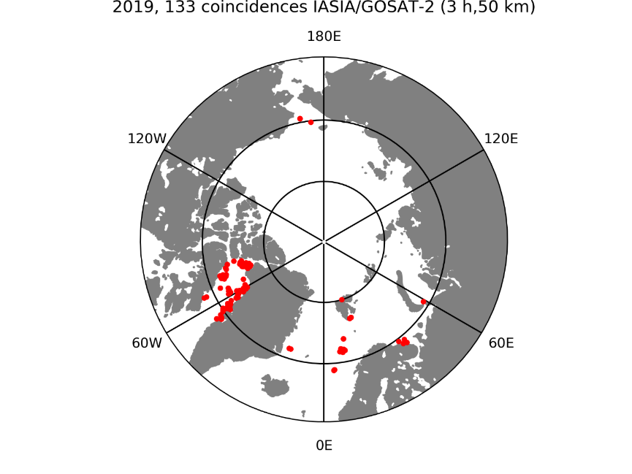
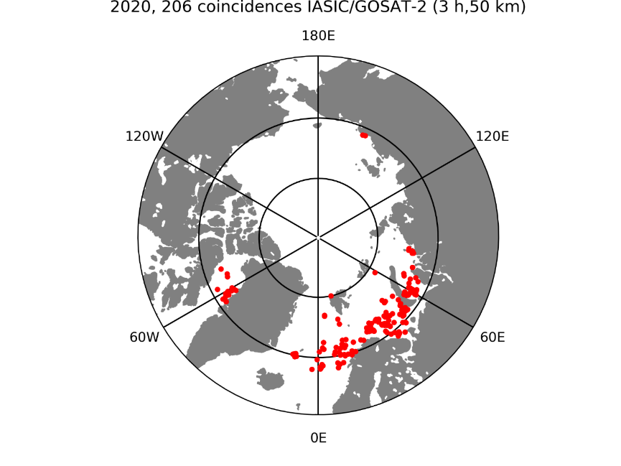
Data selection
Plot of the footprint position of selected coincident IASI-A, B & C, and TANSO-FTS2 "clear, sea, normal lapse rate, good line contrast" for year 2019 and 2020
A third filter is applied on the profiles. We first eliminated all saturated ECMWF ERA5I water vapor profiles. We selected then only IFOVs for which the ECMWF/ERA-5 temperature profile (extracted and interpolated in time and space for any particular footprint) was appropriate. Over the Arctic Ocean, different geophysical situations can occur with respect to the temperature profile. We have distributed 29945 profiles ECMWF T(z) profiles into three classes: negative (normal) lapse rate profiles, temperature inversion below 2 km and quasi-isothermal profiles in the 0-1 km layer and others.

Slide 8
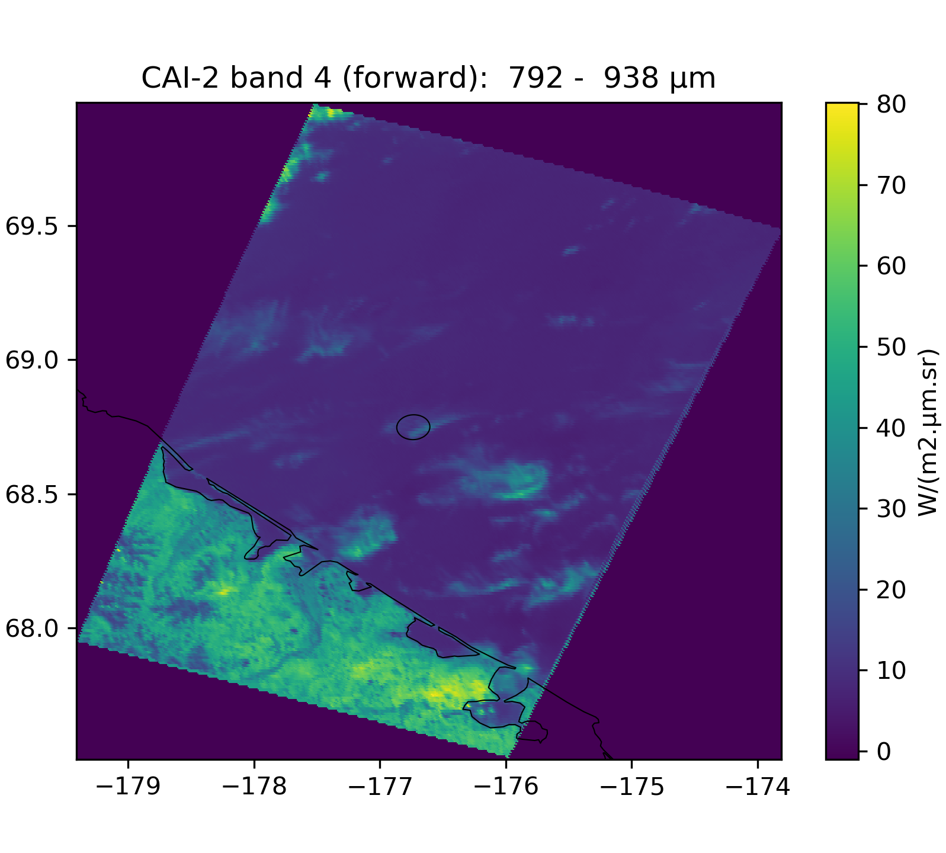
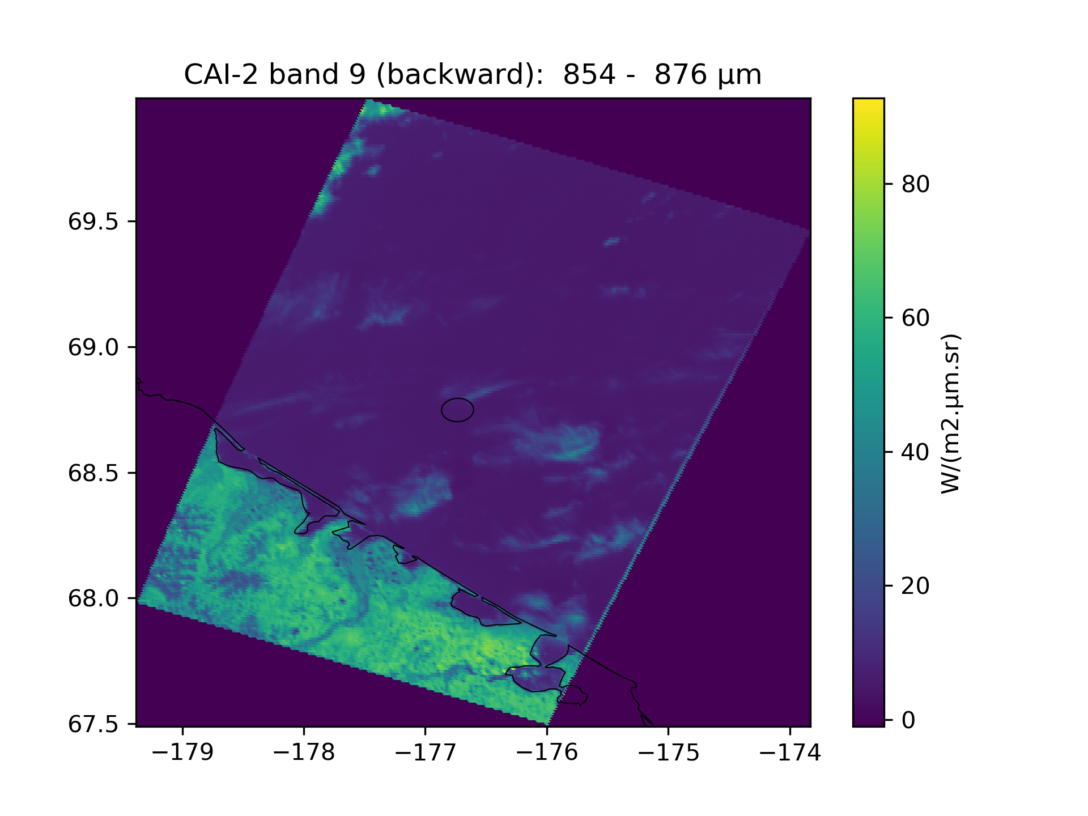
Cloud filtering based on CAI cloud fraction :
Here, date of the FTS-2 IFOV is closest from the one of the forward lines
Comparison between images of forward/backward bands : clouds seems to cross the IFOV between CAI-2 forward and backward measurements → IFOV might not be clear.

Slide 9
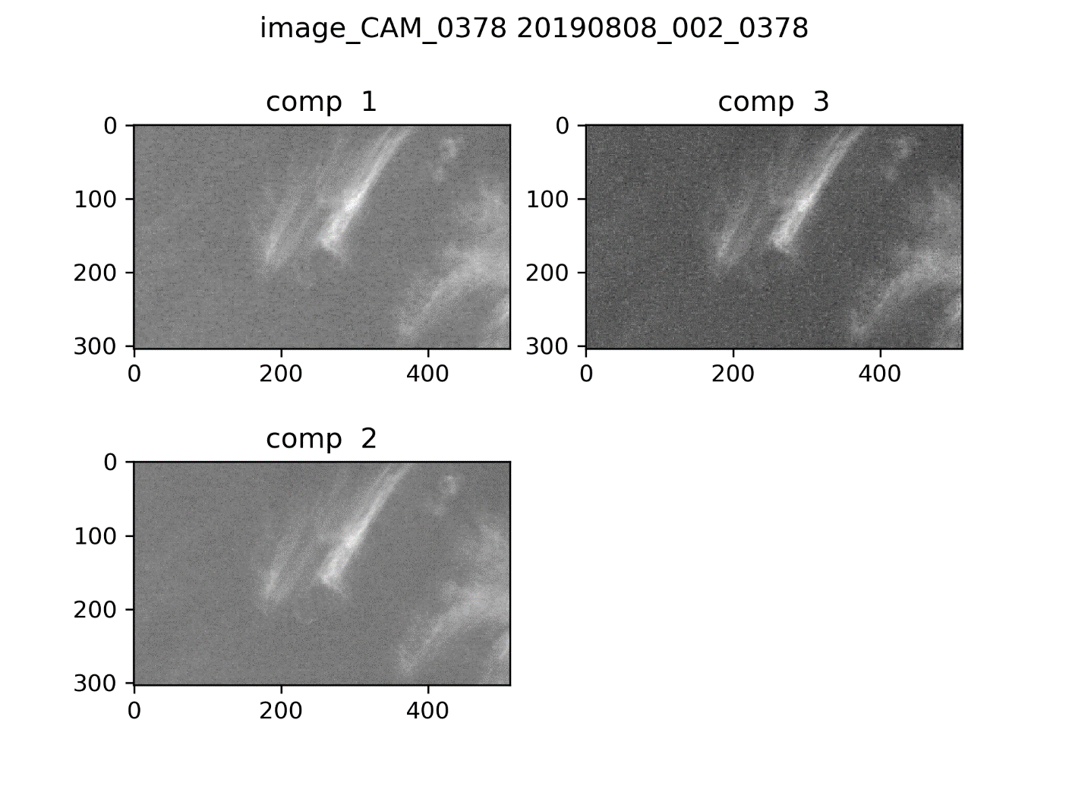
CAI images
Cloud filtering based on CAI cloud fraction :
CAM images
Need to know the exact position of the IFOV in the CAM image to conclude

Slide 10
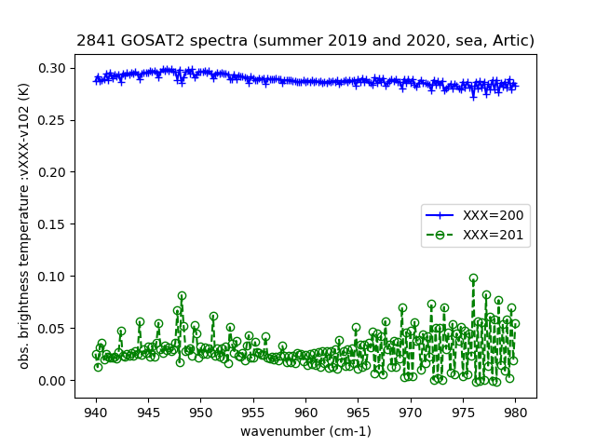
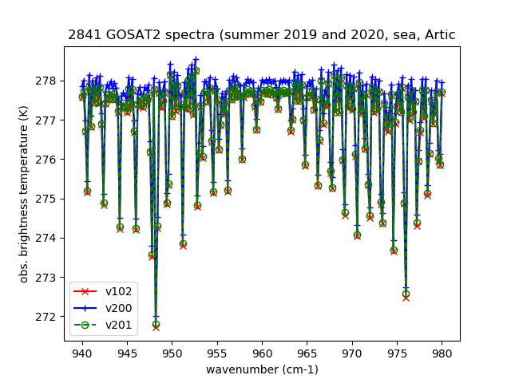
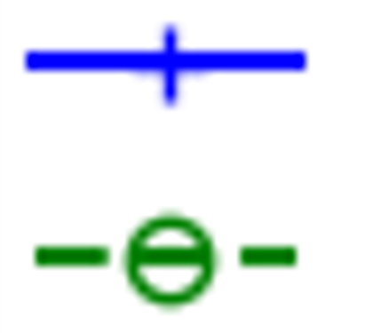
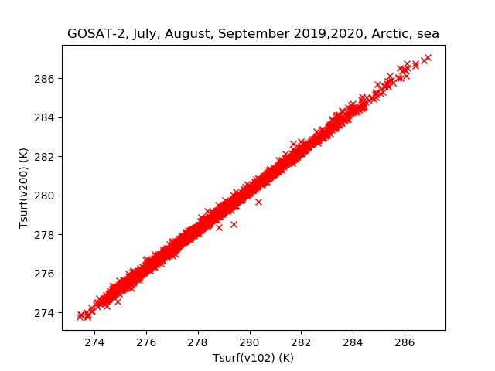
TANSO-FTS2 TIR Spectra versions
V102 – V200
V102 – V200
r = 0,999
T_{V200} = T_{V102} x 0,993 + 1.608 K
Mean(T_{V200} – T_{V102}) = 0,287 K
σ(T_{V200} – T_{V201}) = 0.11 K
Significant change in retrieved T_{surf} for V201
No major change in XCO₂ retrieval (r= 0.982, σ = 3.23 ppmv)

Slide 11
Comparison IASI/GOSAT2
Correlation between T_{surf} derived from TANSO-FTS2 and IASI-B in July/August 2019-2020
Example : IASI-B vs. FTS2 V102 in July and August 2020
r = 0,56
T_{GOSAT2} = T_{IASI} x 0,84 + 4.44 K
Mean(T_{GOSAT2} - T_{IASI}) = -0,46 K
σ(T_{GOSAT2} - T_{IASI}) = 1.65 K
Example : IASI-B vs. FTS2 V200 in July and August 2020
r = 0,90
T_{GOSAT2} = T_{IASI} x 0,97 + 8.63 K
Mean(T_{GOSAT2} - T_{IASI}) = 0,14 K
σ(T_{GOSAT2} - T_{IASI}) = 1.36 K

Slide 12
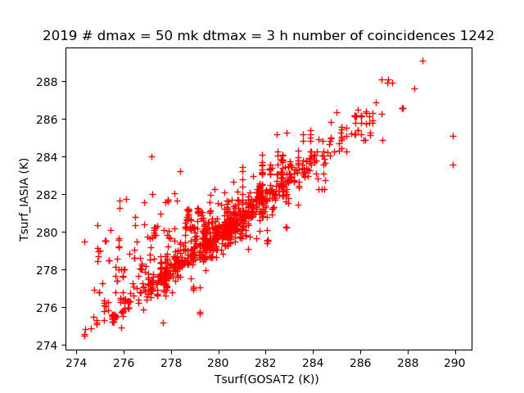
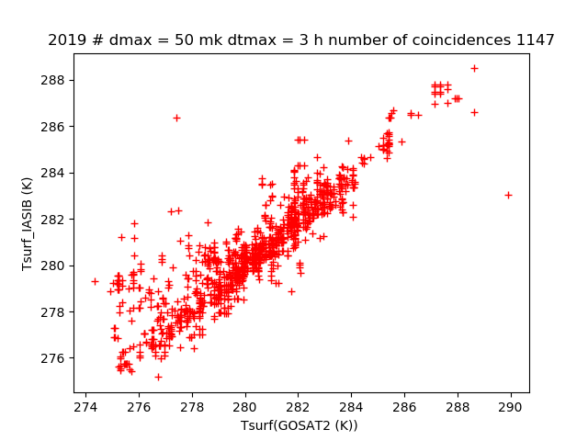
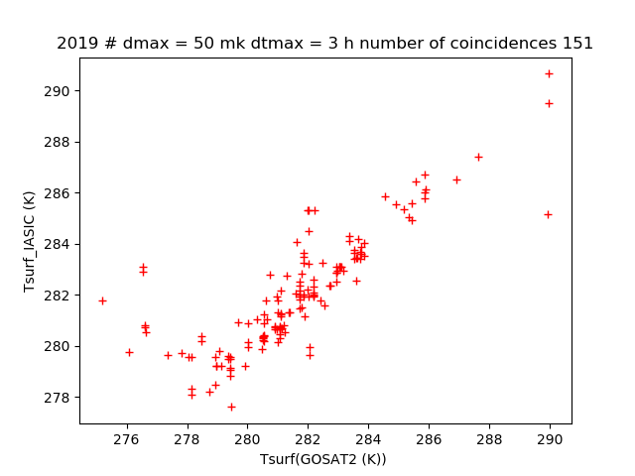
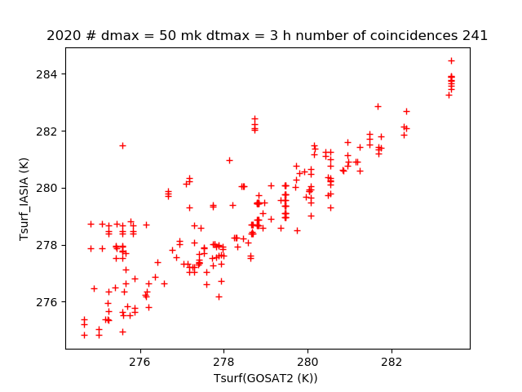
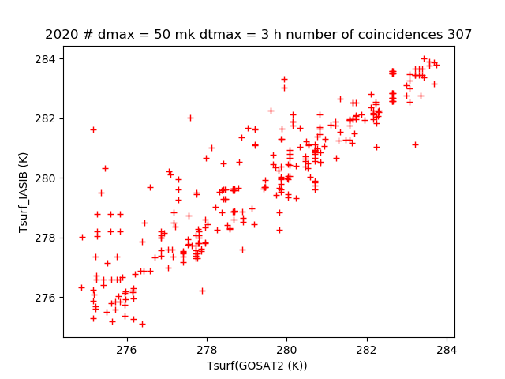
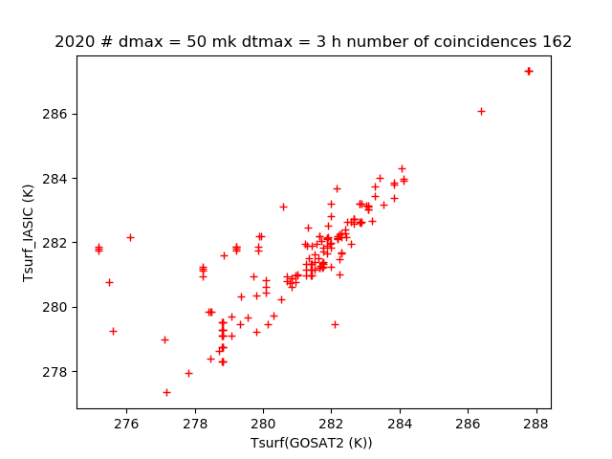
Comparison IASI/GOSAT2
Correlation between T_{surf} derived from TANSO-FTS2 (V201) and IASI-A in July/August 2019-2020
2019
IASI-A
IASI-B
IASI-C
2020

Slide 13
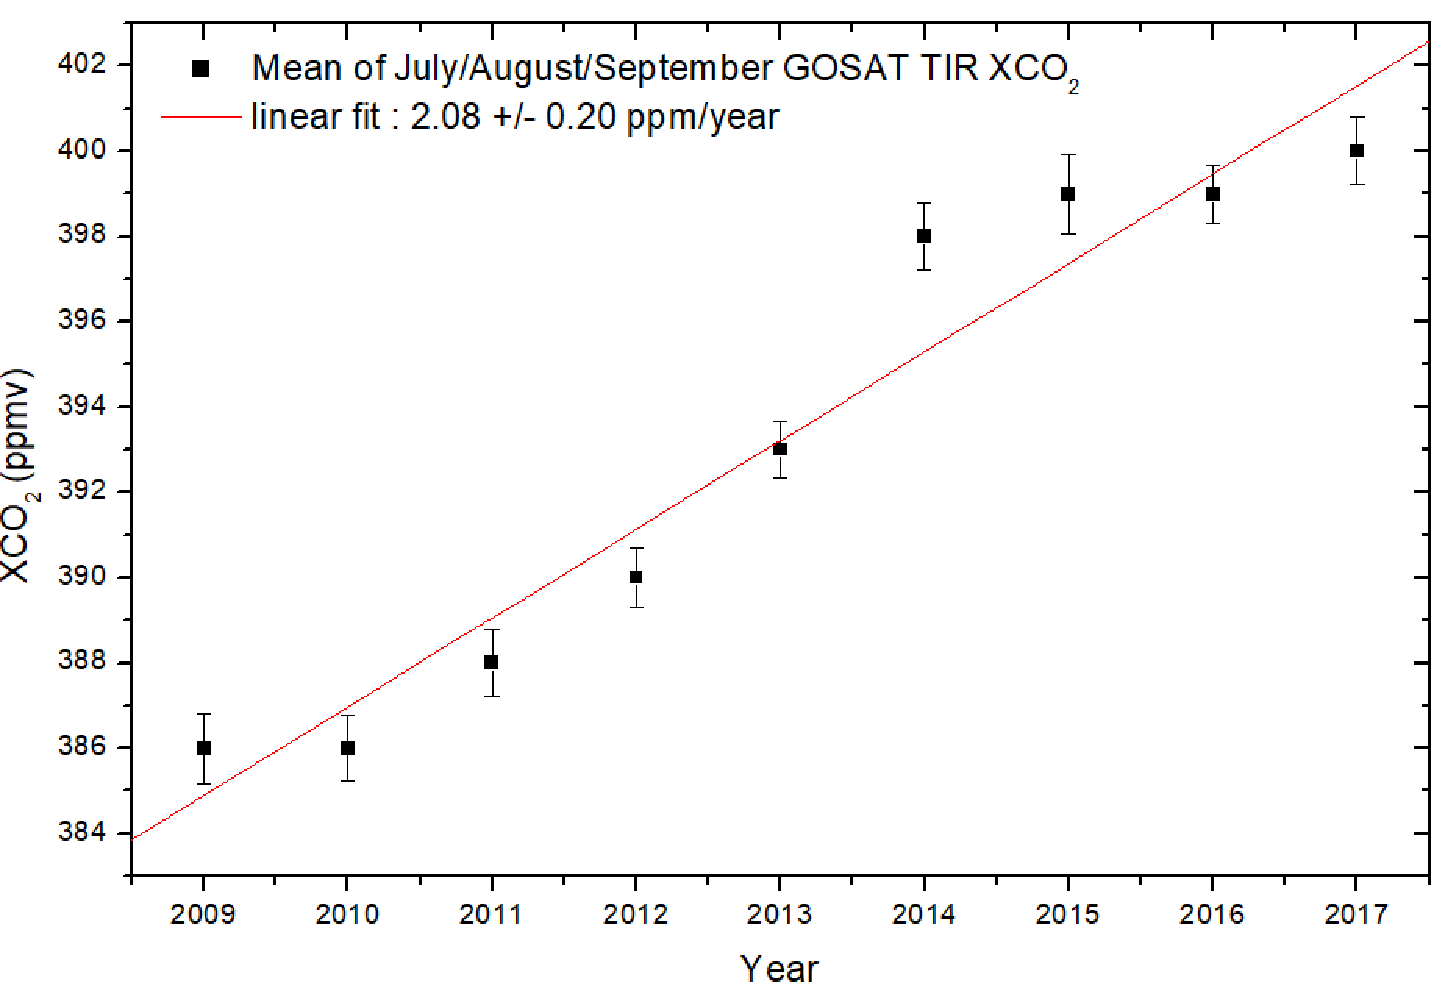
Summary
Based on our experience on quasi-coincidences IASI/GOSAT at high latitude, we perform Cal/Val comparisons of GOSAT-2 with IASI for successive L1b version.
The 3 IASI remain a good reference for checking the new version of TANSO-FTS2 spectra in the TIR region.
We contribute to the radiometric (and spectral) calibration of the two TIR bands of TANSO-FTS-2 spectra.
We have perform intercomparison of GOSAT-2 (TANSO-FTS-2) and IASI-A, B, C retrieved products for nearly coincident footprints.
As for GOSAT previously, it is very important to improve and then confirm the absolute radiometric calibration of TANSO-FTS2 in the TIR for providing series of “climate quality variables” for T_{surf} and possibly CO₂ in the not so well documented Arctic Ocean region not covered by the SWIR/NIR bands
Next step : use of the latest L1B version.
Use of CAM image in addition to CAI2 for cloud filtering under study.
Not presented here but under progression : XSF₆ retrieval
Acknowledgements :
Support from to LATMOS and IPSL
Access to GOSAT and GOSAT2 L1b spectra of NIES and JAXA
French atmospheric data base AERIS and Eumetsat

